Slide 1




Chongqing University of Technology
ATAI
Advanced Technique of Artificial Intelligence
Chongqing University of Technology
Cascaded Semantic and Positional Self-Attention
Network for Document Classification(EMNLP 2020)
Reported by Ting Wang
2020.11.15 • ChongQing

Slide 2

Chongqing University of Technology
ATAI
Advanced Technique of Artificial Intelligence
Chongqing University of Technology
1. Introduction
2. Method
3. Experiments
4. Conclusion

Slide 3
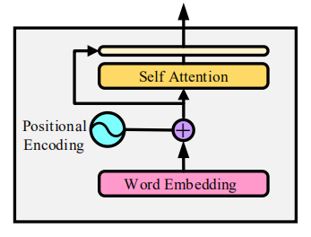
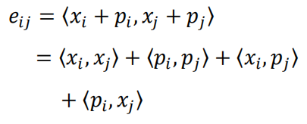





Introduction
Challenge：
How to systematically aggregate semantic information (word embedding) with positional (or temporal) information (word orders).
noise

Slide 4
Introduction
Innovation：
1.Explore a new architecture in combining the semantic and temporal information
in document classification, called “cascaded semantic and positional self-attention network”(CSPAN)
2.It demonstrates very compact model size and fast convergence rate during the training process, which is particularly desirable for large problems.
3.Results on several benchmark datasets demonstrate that our method outperforms state-of-the-art methods.

Slide 5
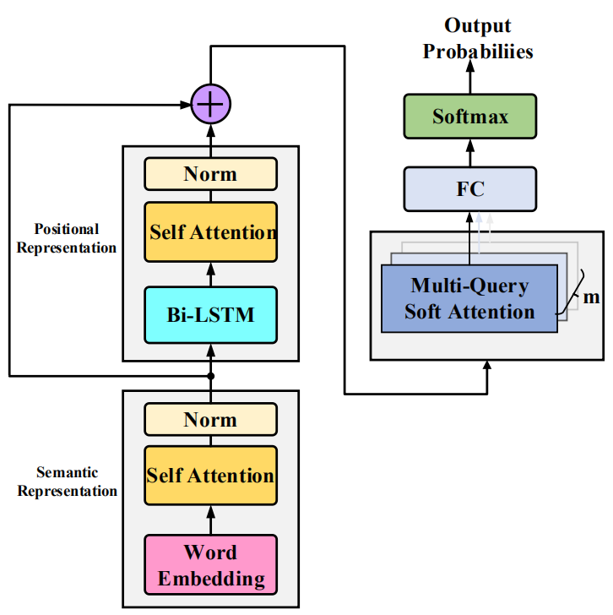

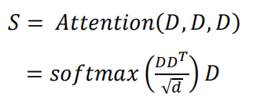

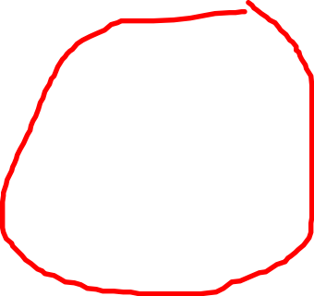
Approach
Semantic Self-Attention:
input sequence:
（1）
self-attention:
（2）
1.

Slide 6













Approach
Semantic and Positional Residual Connection:
Bi-LSTM:
（3）
2.
position-aware:
（4）
residual connect:
（5）

Slide 7








Approach
Multi-Query Soft Attention:
（6）
3.
（7）
（8）
（9）
（10）
（11）

Slide 8
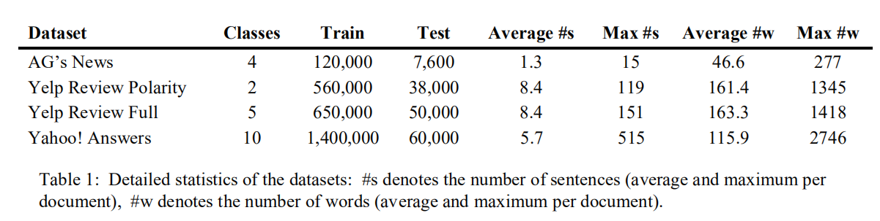




Experiments
Datasets：
AG‘s news: https://www.kaggle.com/amananandrai/ag-news-classification-dataset
Yelp Review Full: https://www.kaggle.com/omkarsabnis/yelp-reviews-dataset
Yahoo! Answers: https://www.kaggle.com/soumikrakshit/yahoo-answers-dataset

Slide 9
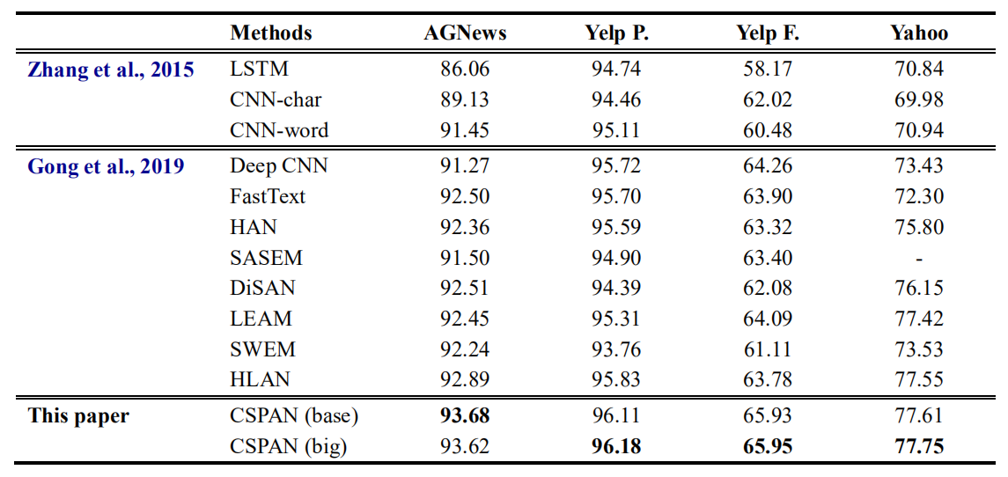

Experiments
base：Single-layer Bi-lstm big: Three hidden layer Bi-lstm

Slide 10
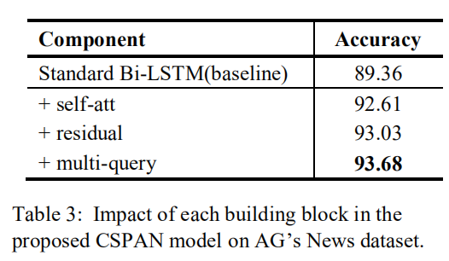

Experiments

Slide 11
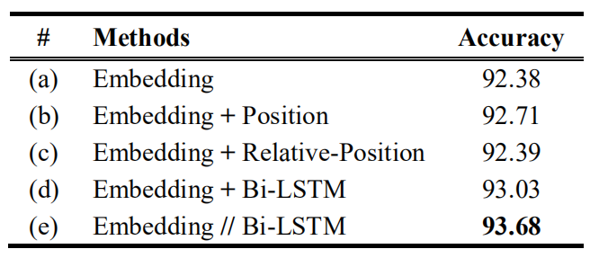
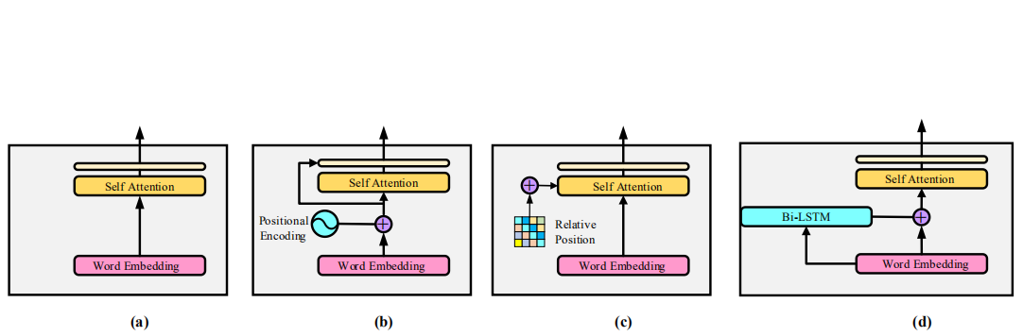



Experiments
Different ways in combining the semantic and the positional information and their accuracy on AG’s News dataset.

Slide 12
Conclusion
We presented the cascaded semantic and positional self-attention to aggregate semantic and positional information in document classification. It overcomes the limitation of existing positional encoding schemes, and shows encouraging performance against state-of-the-art methods using transformers and CNNs. In the meantime, it has a compact model size and is computational efficient. Our studies demonstrate the importance of properly aggregating semantic and positional components, and we will further extend it more challenging NLP tasks in our future research.

Slide 13
Thanks!

